Slide 1
CAT Lab Group Meeting 10-31
Tejas Ramesh

Slide 2
Agenda
Opal: A Modular Framework for Optimizing Performance using Analytics and LLMs
STARK: Strategic Team of Agents for Refining Kernels
My current research- A quick overview

Slide 3
OPAL: A Modular Framework for Optimizing Performance using Analytics and LLMs
Summary of the paper
Develops a framework called OPAL for LLM-led performant code generation.​
Integrates profiled hardware counters and roofline analysis in the framework
Tested by conducting 1640 experiments solely on GPU kernels.

Slide 4
Problem addressed by this paper
Can LLMs, when guided by dynamic performance insights, generate valid and effective code transformations that directly address runtime bottlenecks ?
Background
Roofline analysis: Is the kernel in question compute bound or memory bound ?
Program counter (PC) based sampling: Where in the source code performance stalls occur and what microarchitectural reasons cause them?
Application-Hardware Interaction: Warp divergence, L2 cache misses, shared memory bank conflicts

Slide 5
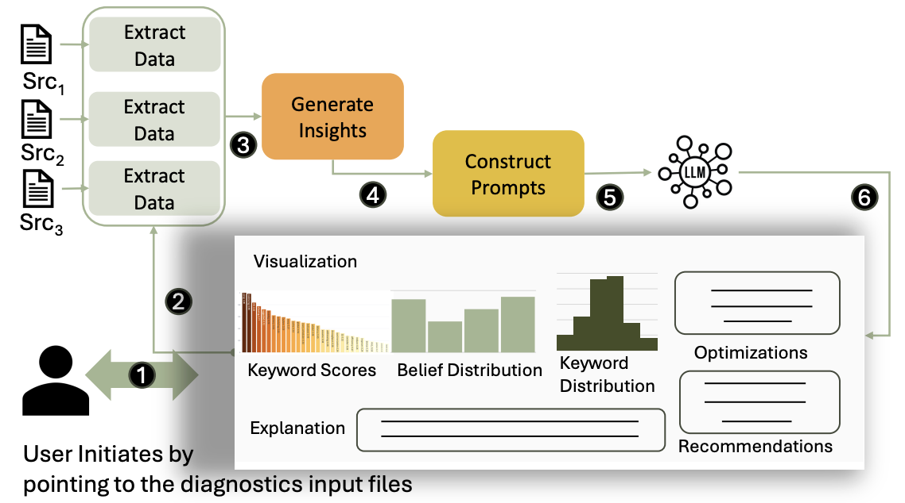
Design Methodology

Slide 6
Extracting insights (Roofline Analysis)
NVIDIA: Uses Nsight Compute’s Roofline insights and diagnostic comments to summarize key bottlenecks and speedup hints.
AMD: OPAL Compares measured vs. peak FLOPs/bandwidth and adds guidance from AMD optimization references.
Extracting insights (Stall Information)
NVIDIA: Uses Nsight Systems’ PC Sampling to map stall events from assembly to source lines, highlighting those exceeding 10% stalls with their causes.
AMD: Processes PC Sampling data similarly, summarizing major stall sources and affected lines for concise, localized optimization insights.

Slide 7
Extracting insights from Hardware Counters
Collects all available hardware counters, then applies sparse feature selection to isolate only those explaining performance variations.
Uses Ensemble Orthogonal Matching Pursuit (OMP) to identify top counters while avoiding local bias and redundancy.
Embeds top-k counter summaries (5 in this study) with natural-language explanations from vendor docs to provide concise, interpretable context.
e.g.: “l1tex__data_bank_conflicts tracks shared memory bank conflicts, typically caused by misaligned or reduction operations, increasing latency."

Slide 8
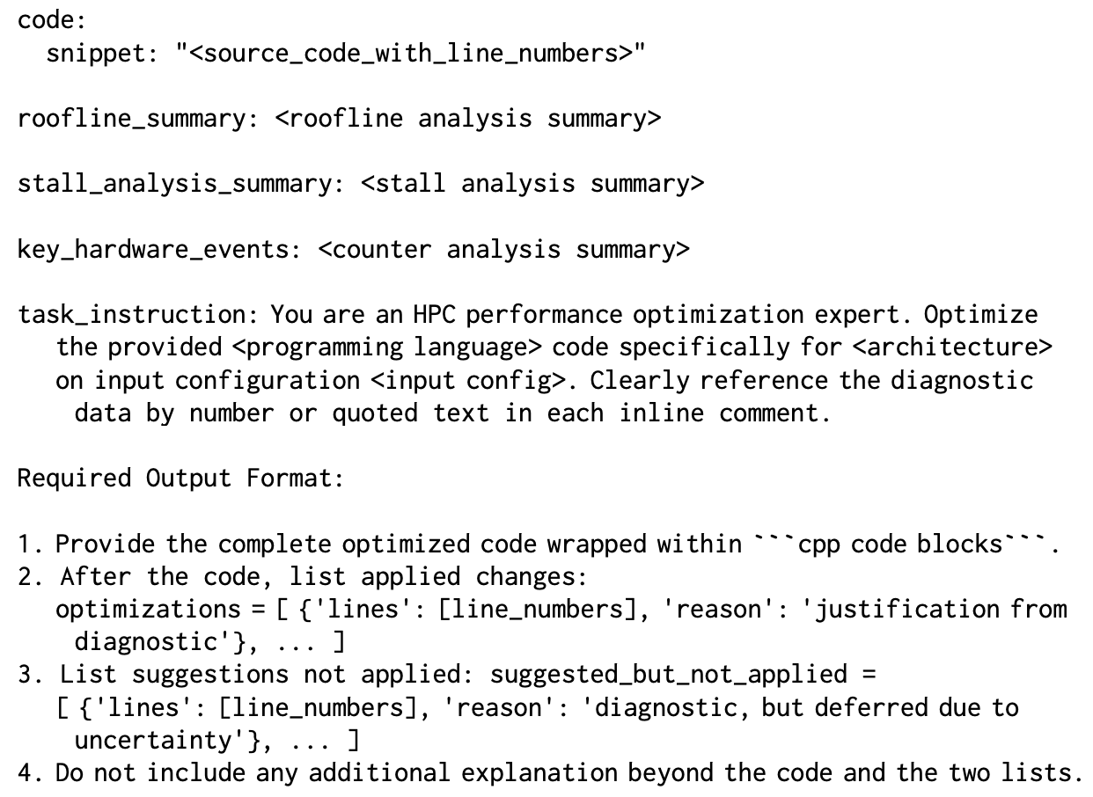
Prompt Template

Slide 9
Justifying LLM output via Belief Tracing
Belief tracing: Uses logprobes (LogProbs API) to compute belief scores from token log-probabilities, mapping model confidence to a [0, 1] scale.
Keyword reconstruction: Merges subword tokens into domain keywords (n-grams ≤ 4) and assigns belief scores to highlight influential phrases.
Filtering and normalization: Removes irrelevant tokens, rescales beliefs, and normalizes values to clearly show which terms guided the model’s reasoning.

Slide 10
Evaluation Framework
Hardware & Tools: Evaluated on NVIDIA H100 and AMD MI210 GPUs using CUDA 12.3, ROCm 6.3.2, Nsight Compute, Omniperf, and GPT-4o; each configuration run 10 times with averaged results.
Benchmarks: Used eight kernels from diverse GPU applications (e.g., Shmembench, Sobol, Accuracy) covering memory-, compute-, and stall-bound behaviors.
Data Collection: Gathered Roofline, PC Sampling, and full hardware counter data for cross-architecture analysis.
Evaluation Design: Compared seven diagnostic combinations (PC, IA, Roofline, and their mixes) against unoptimized baselines, measuring speedups and correctness.

Slide 11
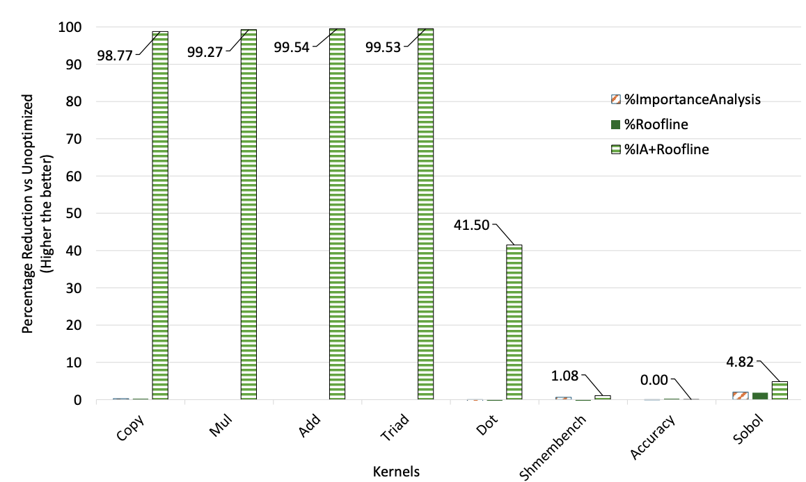
Results

Slide 12
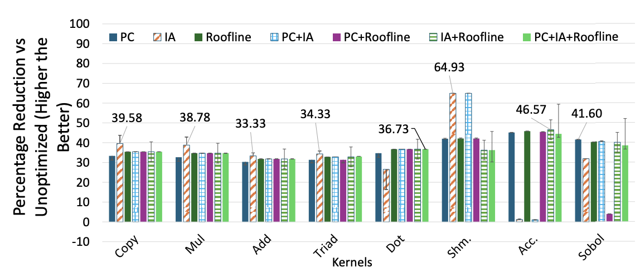
Results

Slide 13
Pros
Actionable insights: Translates complex profiling data into clear, LLM-driven code optimization suggestions.
Explainability: Provides reasoning visibility, allowing users to validate or safely modify transformations.
Cross-architecture utility: Works across NVIDIA and AMD GPUs using standard profiling tools.

Slide 14
Cons
High data collection cost: PC Sampling and profiling can be time-intensive.
Prompt sensitivity: Larger or unfocused prompts can dilute relevant insights, requiring careful tuning.
Semi-manual:Lacks HPC-Commonsense analysis from an optimization relevance standpoint and focuses more on the keyword generation of the LLM. Currently does not integrate any traditional HPC tools (Proposed inclusion in future work)

Slide 15
STARK: Strategic Team of Agents for Refining Kernels
Summary of the paper
Introduces an agentic LLM framework for automated GPU kernel optimization.
Employs multi-agent collaboration, profiling feedback, and iterative refinement to mimic expert reasoning.
Evaluated on KernelBench, achieving correct solutions and up to 16× faster kernel performance than baseline agents.

Slide 16
Problem addressed by this paper
Current LLM agents struggle with shallow exploration that ignores past attempts, inefficient single-agent design that undertakes planning and execution, and a disconnect between high-level optimization plans and correct low-level code implementation, hindering effective kernel optimization.

Slide 17
Key Contributions
Multi-agent design: Uses specialized agents for planning, coding, and reflection to mirror expert workflows.
Plan-to-code alignment: Employs grounded instruction and dynamic context to convert strategies into correct code.
Strategic refinement: Balances exploration and exploitation to iteratively discover better-performing kernels.

Slide 18
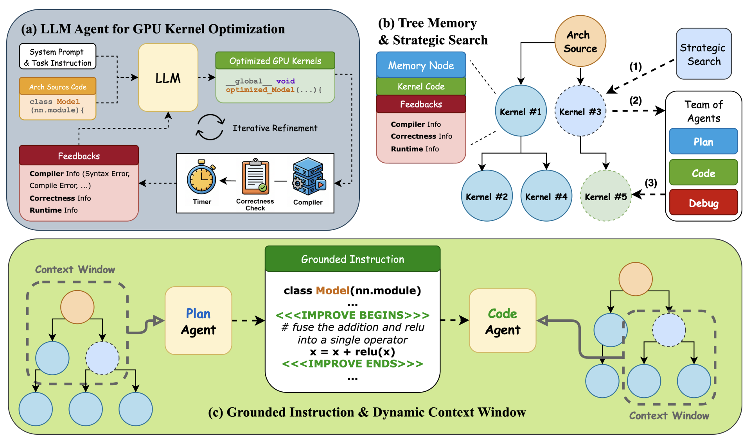
Design Methodology

Slide 19
Multi-Agent Collaboration
Decomposes GPU-kernel optimization into planning, coding, and debugging agents, each with specialized prompts and objectives.
Uses temperature control (high for planning, low for coding/debugging) to balance exploration diversity with code precision.
Enables modularity and fine-tuning. Individual agents can be swapped or retrained independently to enhance stability and accuracy.

Slide 20
Strategic Search with Memory
Represents kernel optimization as a persistent search tree, where each node stores code candidates and performance outcomes.
Uses an adaptive exploration strategy that avoids repeating failed edits and balances trying new ideas with improving good ones.
Turns random trial-and-error into a guided search process, learning from past runs to find faster and more correct kernels

Slide 21
Grounded Instruction and Dynamic Search Context
Grounded instruction tags precise code regions (<<<IMPROVE BEGINS>>> ... <<<IMPROVE ENDS>>>) for edits, ensuring alignment between planning and implementation.
Dynamic context windows give each agent a custom view of past runs, planners see top-performing kernels, coders see related successful or failed versions, and debuggers see fixes from similar kernels.
Improves traceability, reuse of successful patches, and reduction of redundant or faulty edits, enhancing reliability over iterative runs.
Imagine the plan agent previously tried loop unrolling and vectorization on similar kernels. When the code agent starts optimizing a new kernel, its context window includes successful sibling versions which lets it choose the best trade-off applying the proven unroll factor.

Slide 22
Results
Baselines and Metrics
Torch Eager- The out-of-box PyTorch modules without any compilation or optimization.
Torch Compile- We use torch.compile to produce optimized versions of the given PyTorch modules.
Sampling Agent- The single agent framework originally proposed and used by KernelBench
Reflexion Agent- This agent follows the Reflexion paradigm, where at each optimization step, it tries to update its last attempt using its corresponding observations such as the compiler and runtime information.

Slide 23
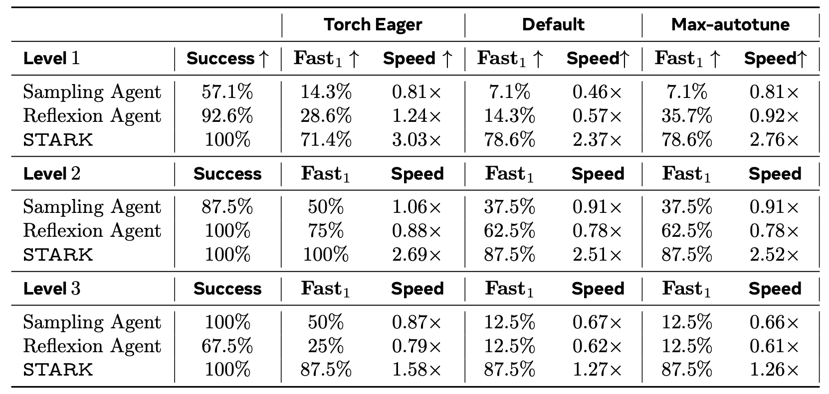
Results

Slide 24
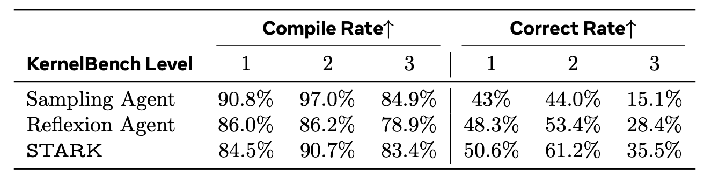
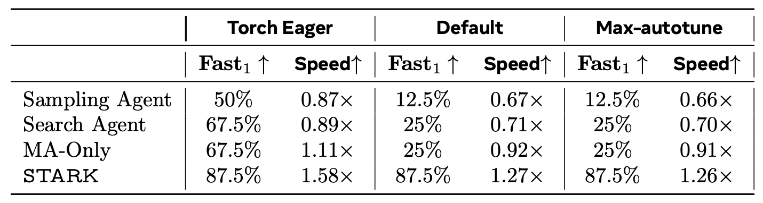
Results

Slide 25
My Current Work-PerfAgent
PerfAgent is an Agentic-AI framework that is based on the OpenHands project.
In addition to existing tool invocation capabilities of OpenHands, PerfAgent extends the arsenal of tools to more traditional, HPC-specific ones.
Which includes Codee, HPCToolkit and HPCAnalysis.

Slide 26
What we intend to address ?​​
Evaluate the capabilities of LLM Agents for code generation/optimization tasks in the High-Performance Computing domain.​​
Although enough work in the space of LLMs for code generation has been done, Agentic workflows could mitigate the short comings of LLMs​.
Challenges with Standalone LLMs​
Limited Context​​- Unable to pass function calling contexts and large code snippets due to context window limitations.​​
HPC specific awareness​​- LLMs have limited knowledge when it comes to improving performance codebases over varying underlying architectures using parallel optimization strategies.​​
Failure to comply with instructions​​- LLMs are found to not comply with instructions provided (generating incorrect codes)and sometimes even hallucinate in code generation tasks.​​

Slide 27
Tools
Codee
The agent will invoke Codee to generate a performance report of the existing source code to identify potential optimization opportunities.​
After which the agent can apply the optimizations​ suggested by the tool.
Input: HPC Source Code
Output: Performance Screening report and optimization suggestions
​

Slide 28
Tools
HPCToolkit
The agent will invoke HPCToolkit to automatically profile the HPC codebase to gain an understanding of crucial performance metrics.​
The first round of profiling is done on the original code and subsequent rounds of profiling are done after each round of optimizations are applied by the agent. ​
​
Input: HPC benchmark codebase​
Output: Database of profiling metrics​
​

Slide 29
Tools
HPCAnalysis
The agent will invoke HPCAnalysis to generate performance reports/insights from the HPCToolkit databases generated by HPCToolkit in the previous step to gain an intuitive understanding of issues with crucial performance metrics.​
​
Input: HPCToolkit Database
Output: Insightful slices of HPCToolkit profiling data to mitigate performance issues/bottlenecks
​

Slide 30
Tools
HPCAnalysis
The agent will invoke HPCAnalysis to generate performance reports/insights from the HPCToolkit databases generated by HPCToolkit in the previous step to gain an intuitive understanding of issues with crucial performance metrics.​
​
Input: HPCToolkit Database
Output: Insightful slices of HPCToolkit profiling data to mitigate performance issues/bottlenecks
​

Slide 31
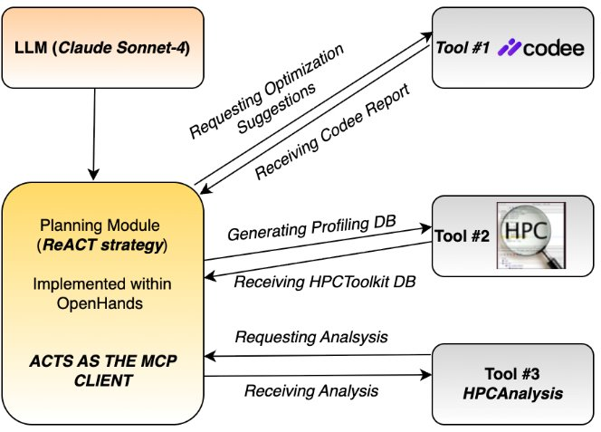
Model-Context Protocol (MCP)
Plan for defining tools would follow the Model Context Protocol (MCP)​

Slide 32
MCP (Cont.)
Currently, we define the tools using FastMCP (Supported by OpenHands framework already)
Defined on Hopper (localhost) that acts as the server.
The agent can invoke tools based on short descriptions provided as part of the tool definition.
Upon Invocation with no parameters- Help text for each tool is displayed for the LLM to learn how to invoke the tools.

Slide 33
Performance Optimization Workflow-A case study- Optimizing ADI Benchmark
Background
The agent has access to all pre-existing tools as part of OpenHands as standard. (IPython execution, Bash command execution etc.)
Additionally, we now augment it with MCP Tool calling for HPC-Specific tools.
We provide a comprehensive system prompt for HPC workflows that makes the agent aware of its capabilities.

Slide 34
System Prompt
<ROLE_AS_A_HPC_CODE_OPTIMIZER>
*You have been provided with niche High-Performance Computing specific code optimization, profiling and analysis tools via Model-Context Protocal (MCP) you can use the tools mentioned below in order to improve your optimization strategy with every iteration
*To understand how to compile applications make use of makefiles available in the HPC benchmark folders
*You can use your intelligence to come up with innovative additional profiling metrics supported by HPCToolkit for the application you wish optimize by analyzing the program structure, nature and performance results from each previous optimization iteration
*The environment you perform optimizations in is equipped with all necessary libraries and files and MCP Tool dependenices are taken care of at the time of tool invocation.
*To learn how each tool works you can invoke them without any inputs to see their behaviour.
1. OPTIMIZATION: Make use of the Codee Tool to get optimization suggestions for the code the user is trying to optimize
2. PROFILING: Make use of the HPCToolkit Tool to generate profiling databases from the code the user is trying to optimize
3. ANALYSIS: Make use of the HPCAnalysis Tool to gain insights from the HPCToolkit profiling databases generated
</ROLE_AS_A_HPC_CODE_OPTIMIZER>

Slide 35
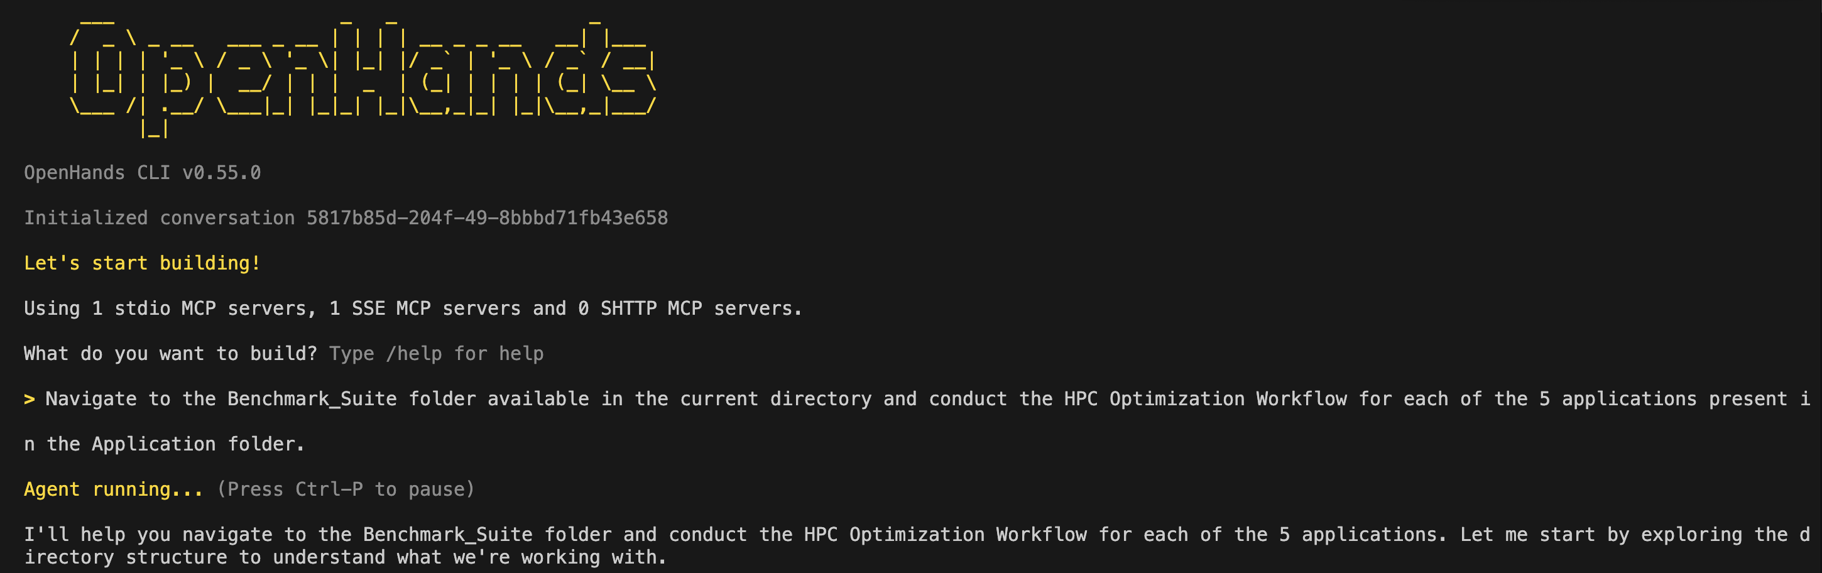
Case Study (Cont.)
Task at hand (Only User Input Apart from Permissions)
Navigate to the Benchmark_Suite folder available in the current directory and conduct the HPC Optimization Workflow for each of the 5 applications present in the Application folder.

Slide 36
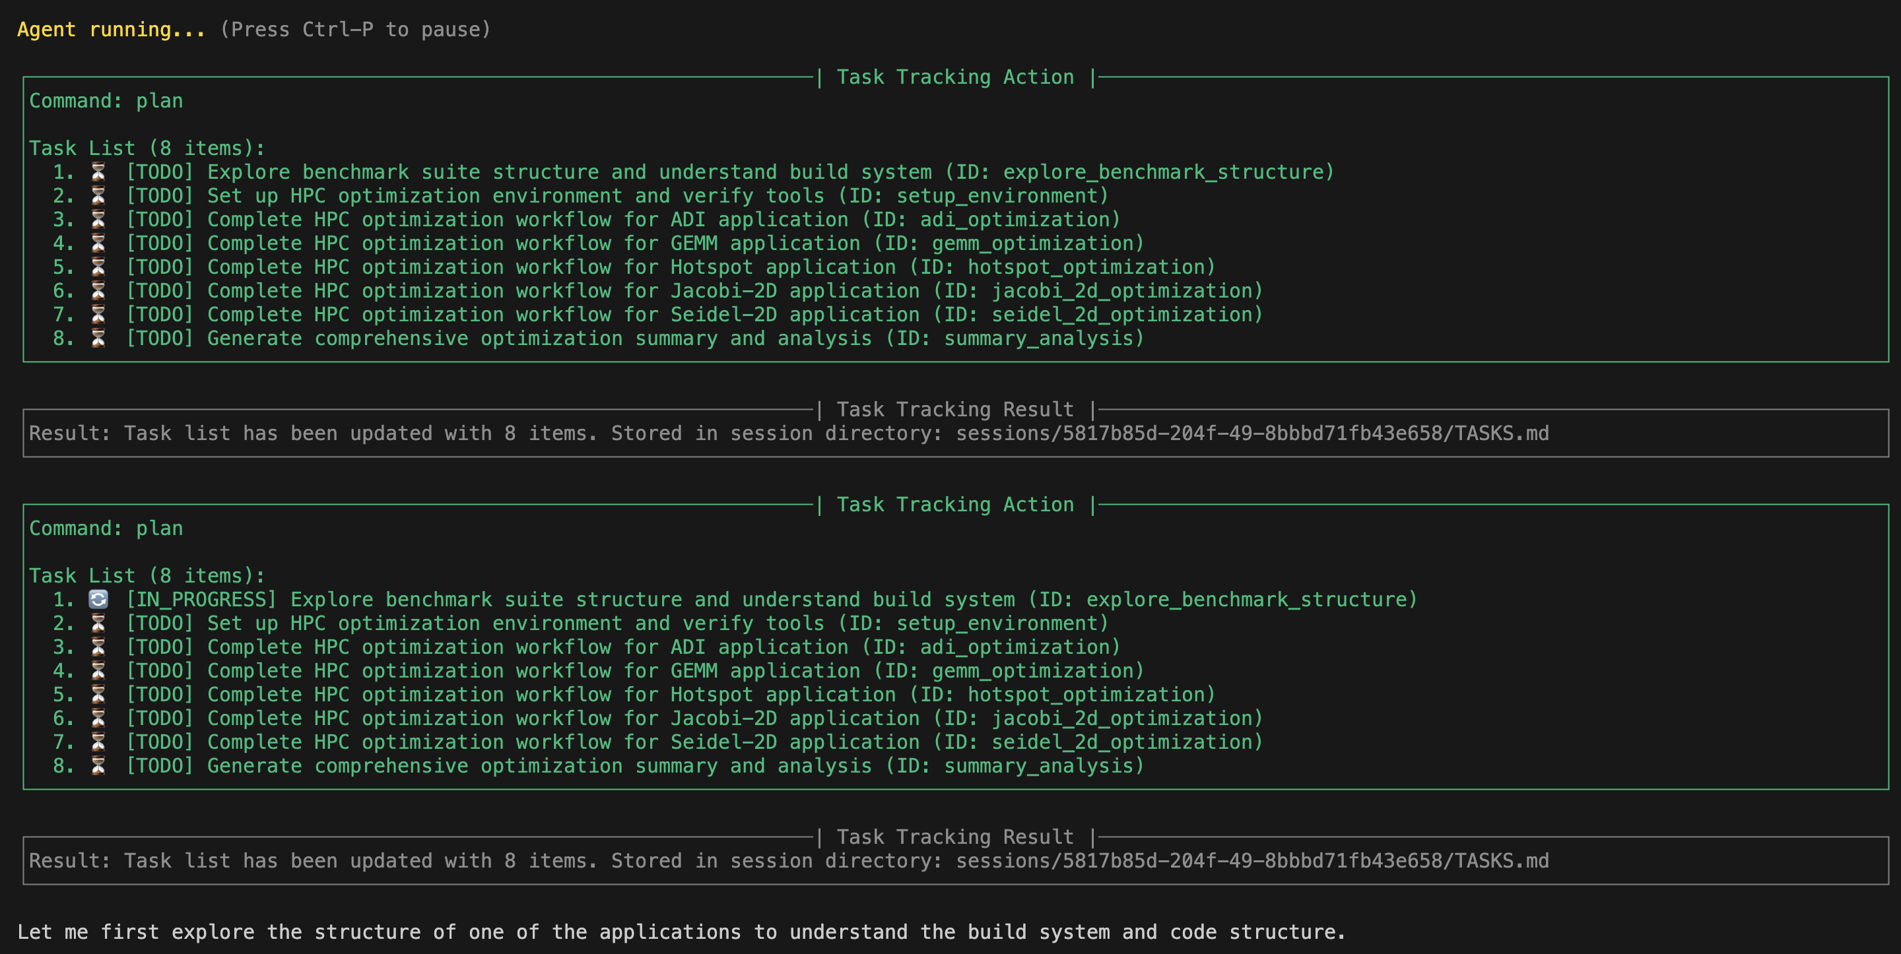
Plans a Roadmap Ahead

Slide 37
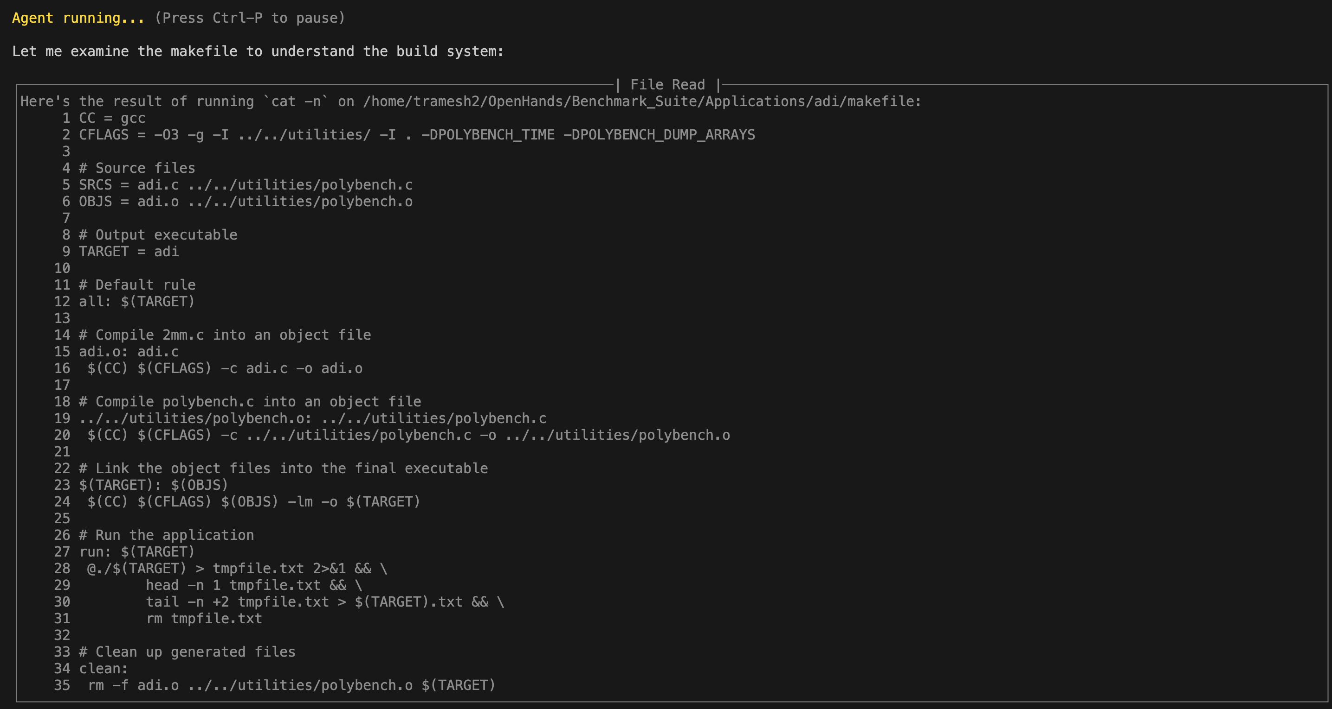
Reads the Makefile to understand compilation dependencies

Slide 38
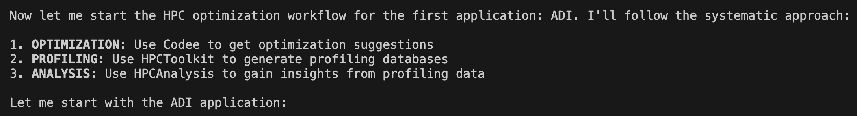
Task Update (Cont.)

Slide 39
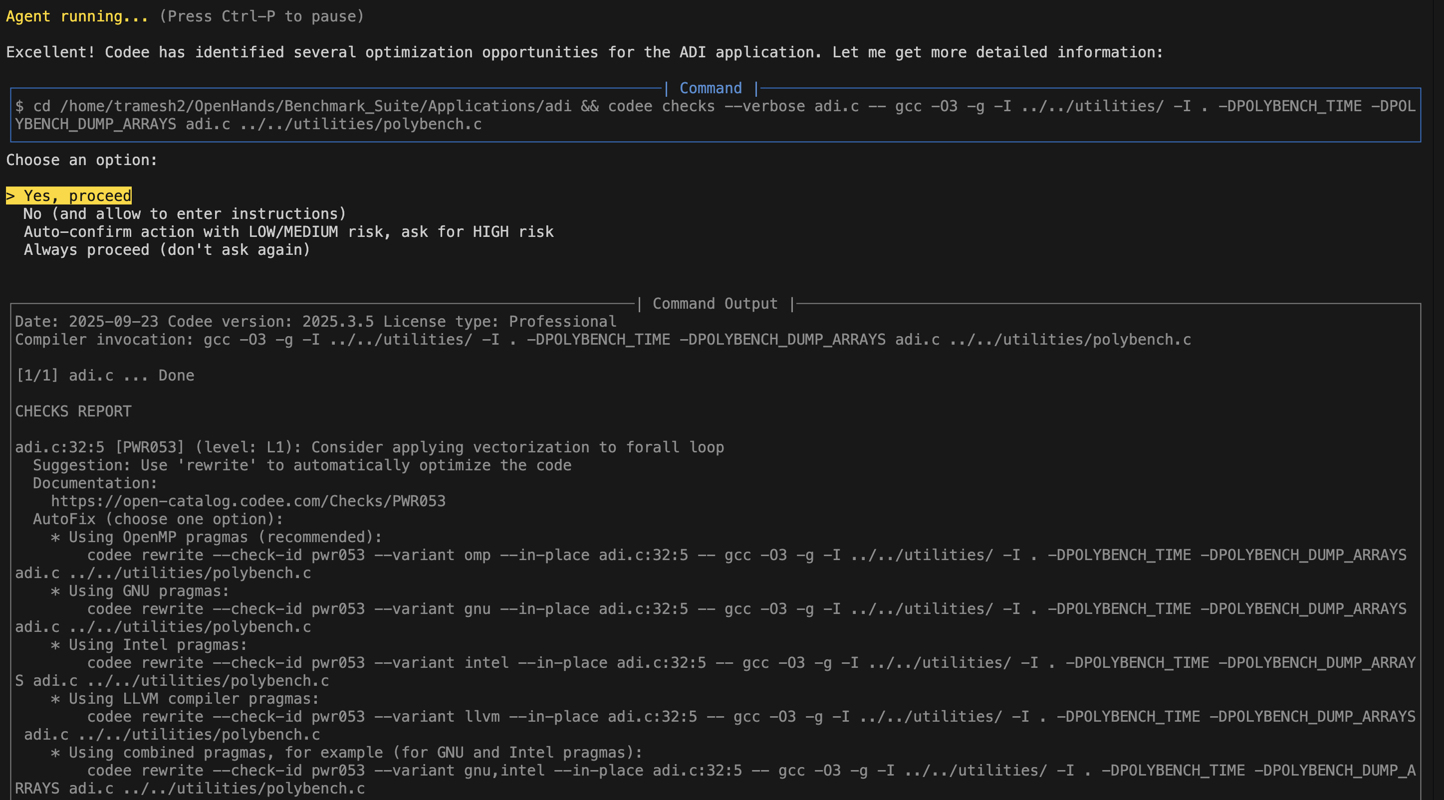
Invoking Codee (Third Attempt-Successful)

Slide 40
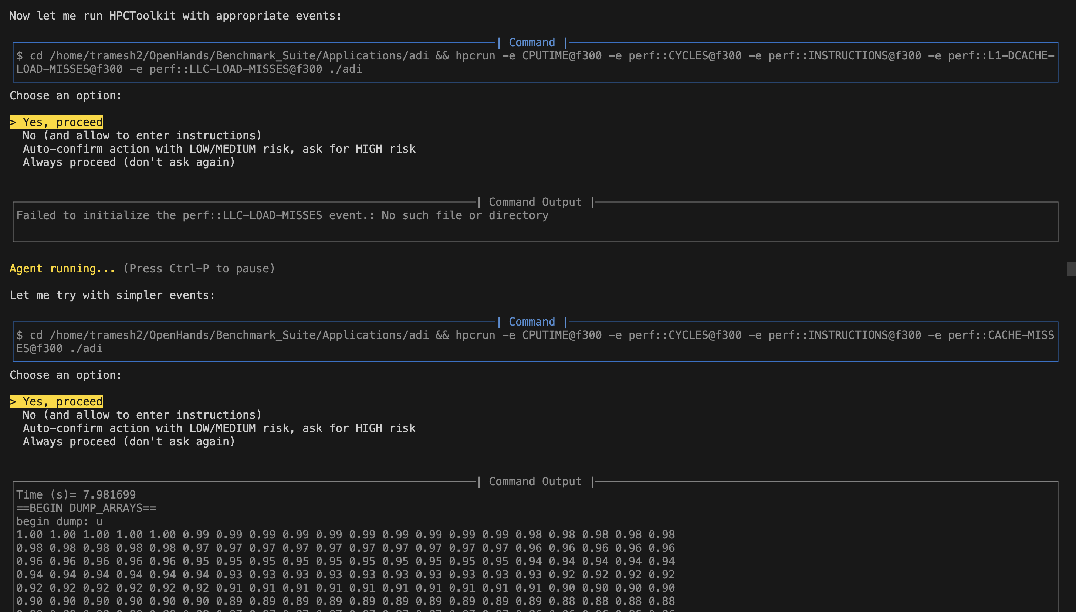
Invoking hpcrun to Profile Baseline

Slide 41
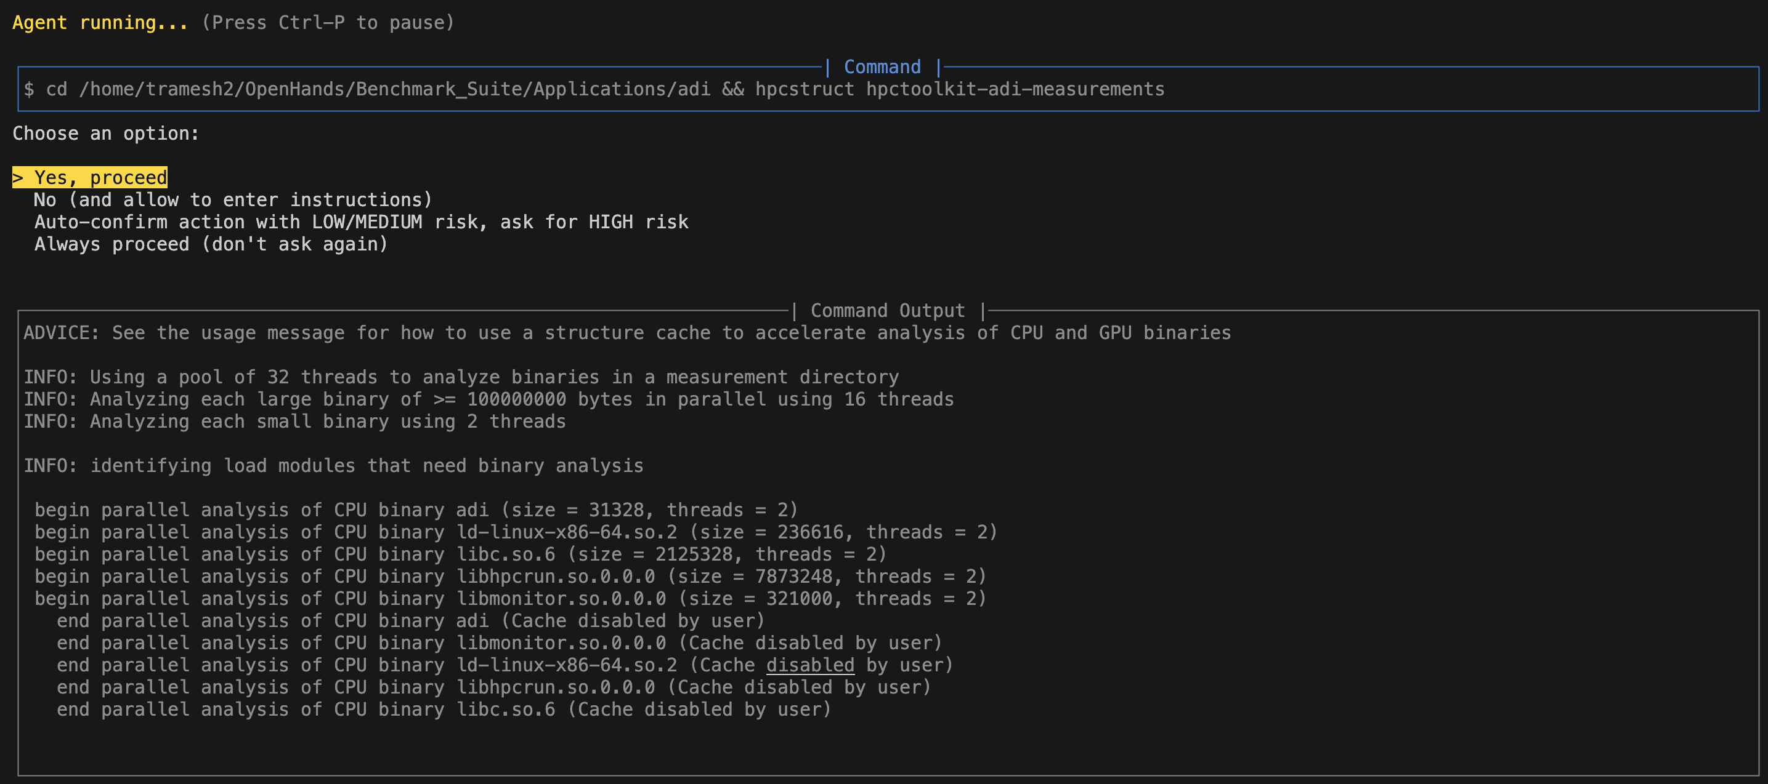
Invoking hpcstruct to Profile Baseline

Slide 42
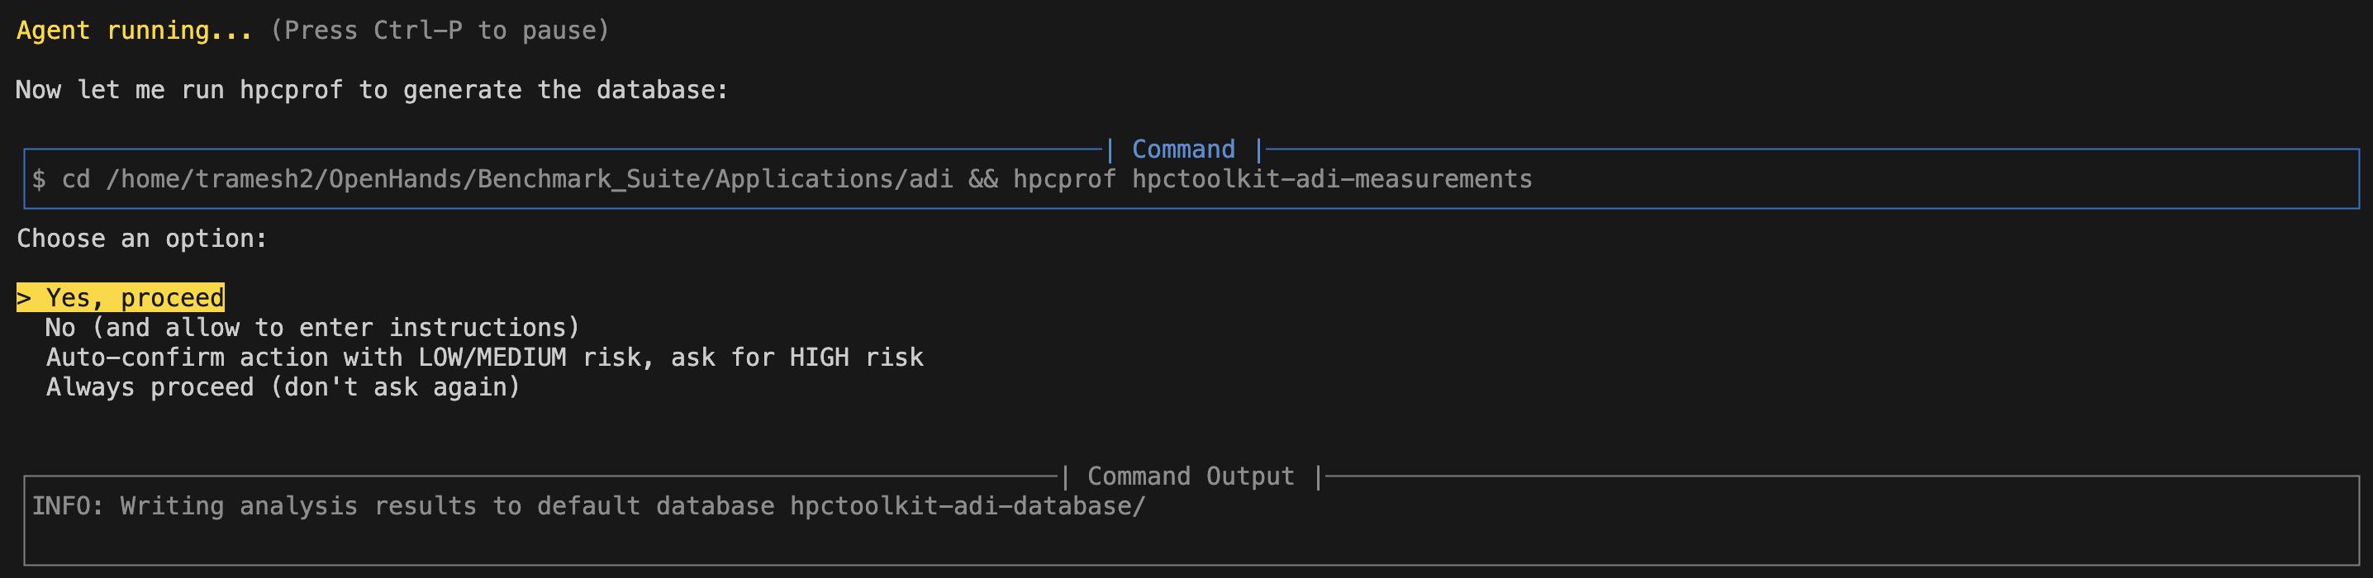
Invoking hpcprof to Profile Baseline

Slide 43
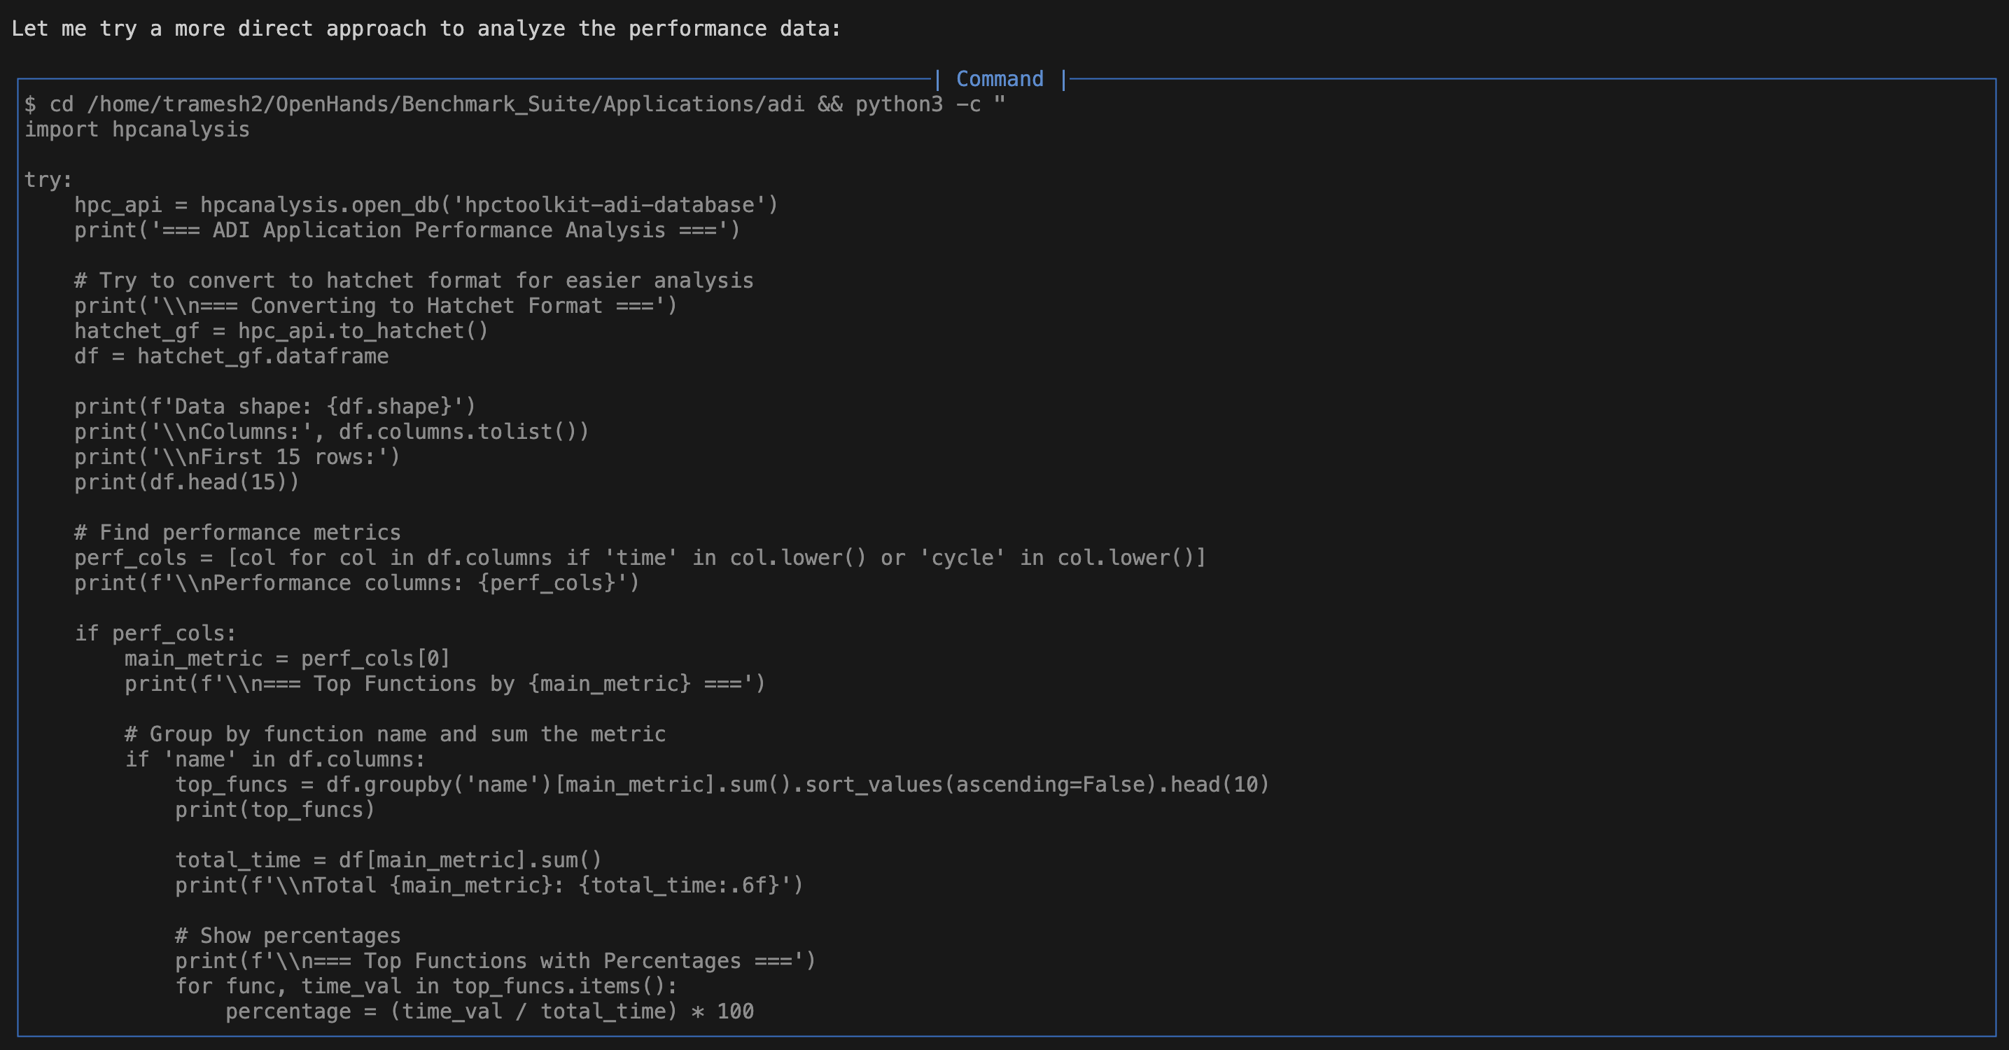
Invoking HPCAnalysis with Hatchet API

Slide 44
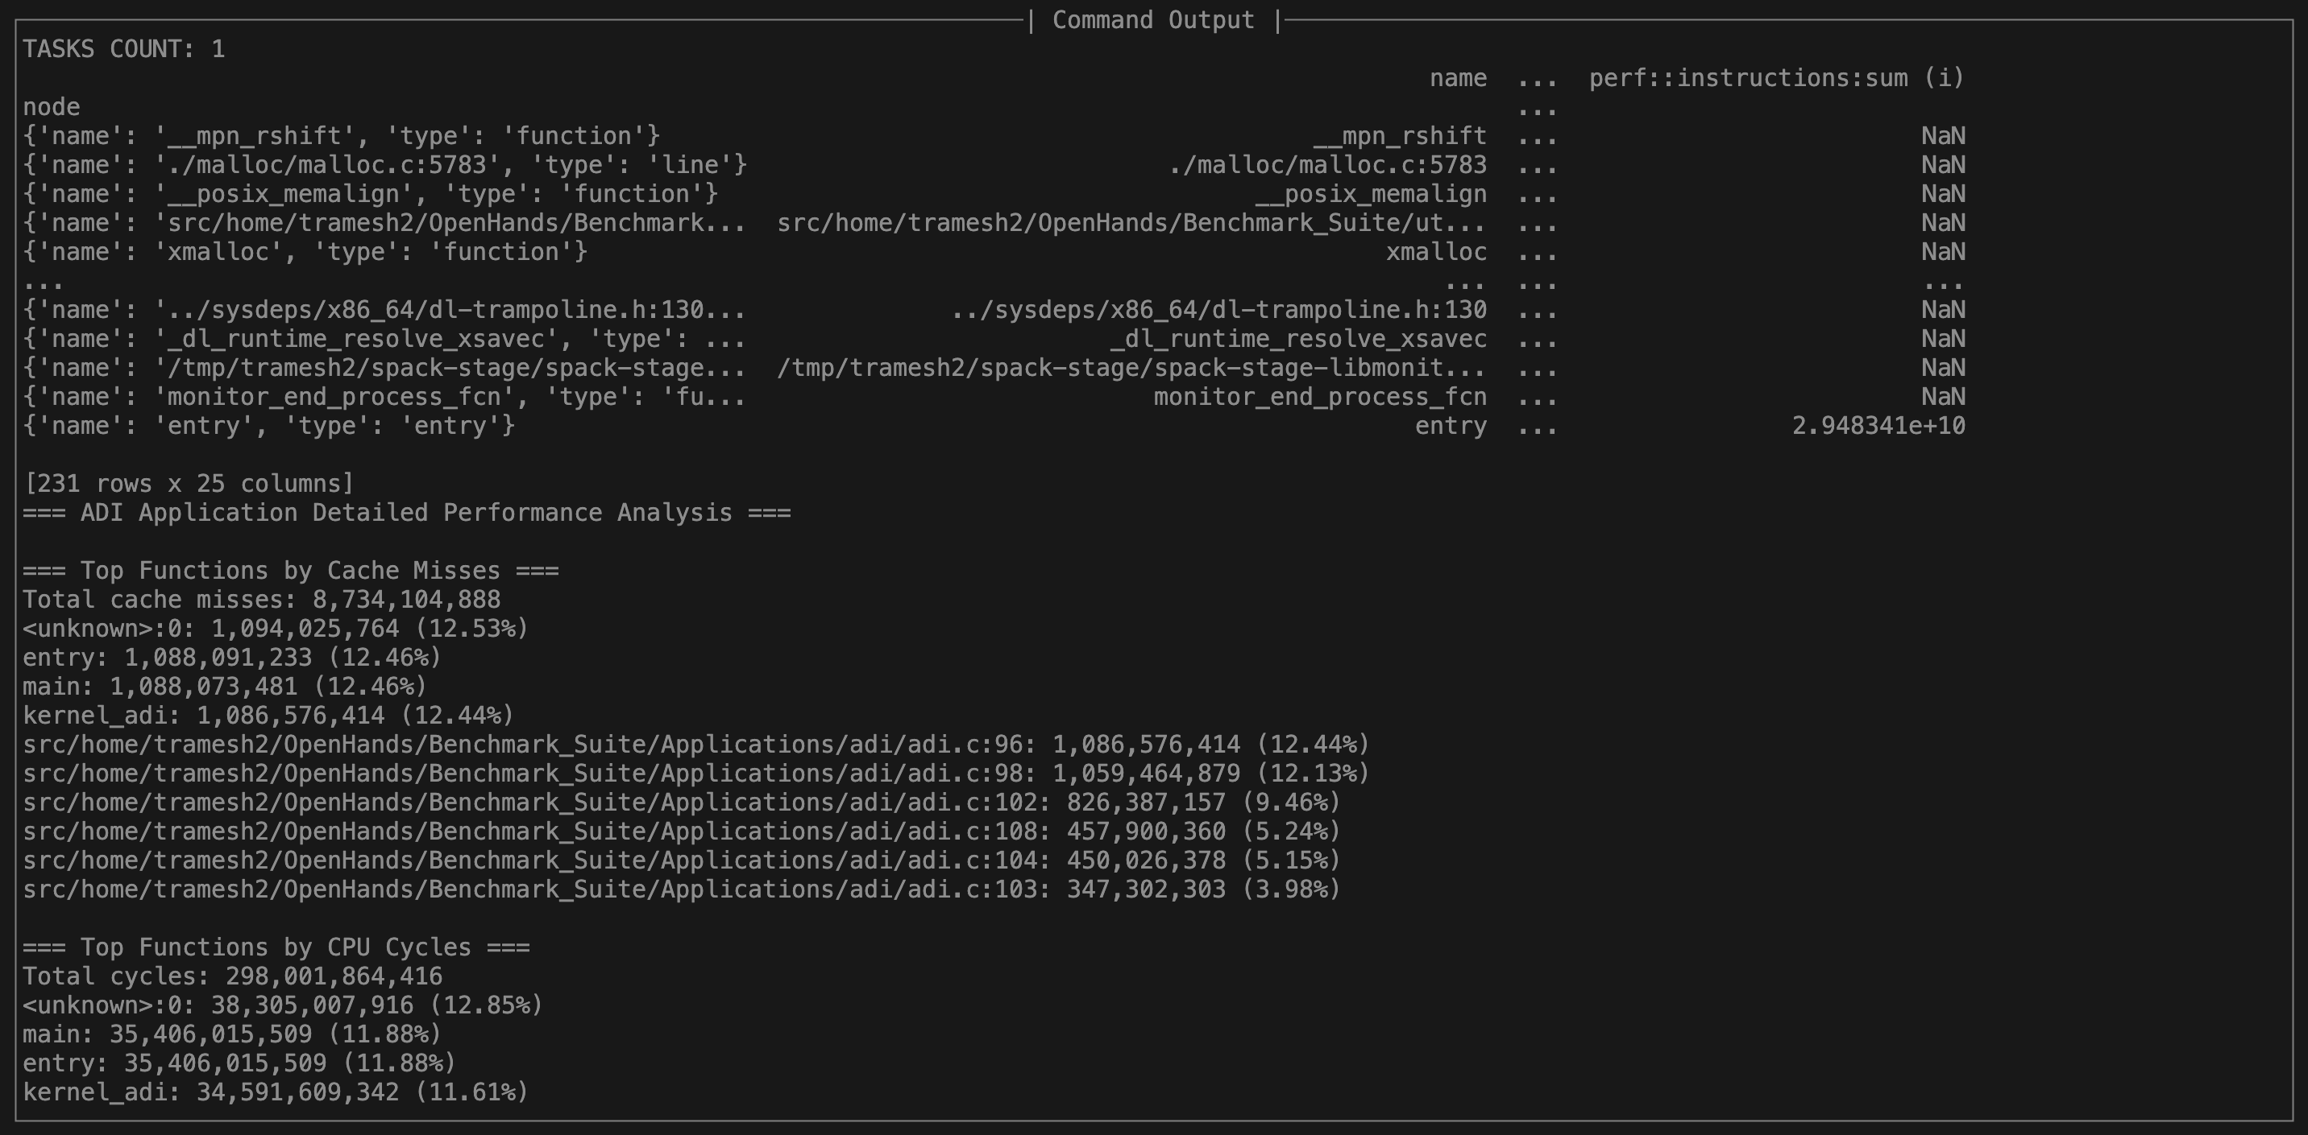
Gets Cache Information

Slide 45
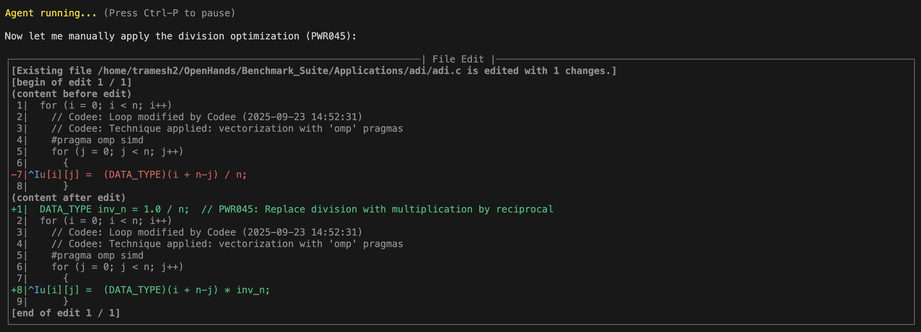
Applying Codee Suggested Manual-Fix

Slide 46
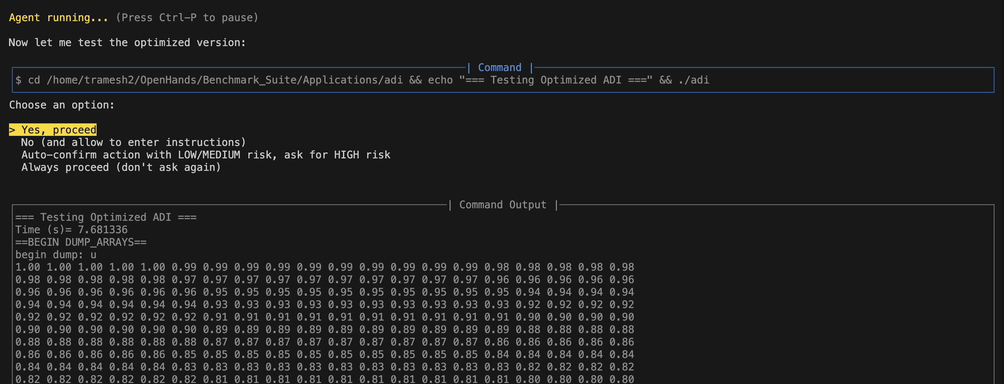
Benchmarking the optimized version

Slide 47
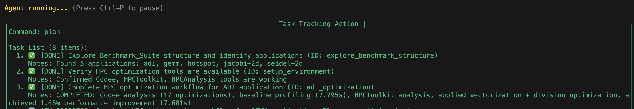
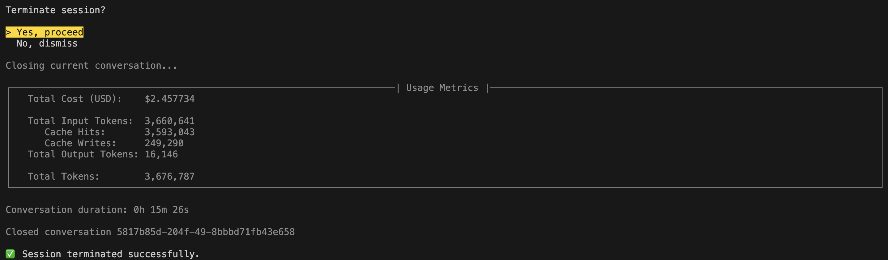
Task Update and Session Summary

Slide 48
Future Improvements
Provide more comprehensive System Prompts (Implementing ReACT prompting strategy for Tool Calling)
Place Emphasis on Correctness
Achieve a single attempt tool call success rate.
Implement strategies to improve innate LLM HPC-Commonsense (RAG/Web surfing augmentation)

